Slide 1


CNTK The Microsoft Cognitive Toolkit

Slide 2

Overview
Introduction to CNTK
Deep Learning at Microsoft
Building Blocks – Code Highlights
Backend for Keras

Slide 3
Introduction to CNTK

Slide 4
The Microsoft Cognitive Toolkit (CNTK)
Microsoft’s open-source deep-learning toolkit
Ease of use
Fast
Flexible
Internal=external version
Composes simple building blocks into complex networks
Production-ready:
State-of-the-art accuracy, efficient, and scales to multi-GPU/multi-server

Slide 5
The Microsoft Cognitive Toolkit (CNTK)
Open-source model inside and outside the company
Created by Microsoft speech researchers (Dong Yu et al.) in 2012; open-sourced (Codeplex) in early 2015
On GitHub since Jan 2016 under permissive license
“working out loud:” virtually all code development is out in the open
Used by Microsoft product groups
CNTK-trained models power more and more Microsoft products
Several teams have full-time employees on CNTK that actively contribute
External contributions e.g. from MIT and Stanford
Linux, Windows, docker, cudnn5

Slide 6
Deep Learning at Microsoft

Slide 7







Deep Learning at Microsoft
Microsoft Cognitive Services
Skype Translator
Cortana
Bing
HoloLens
Microsoft Research

Slide 8
Deep Learning at Microsoft
ImageNet: Microsoft 2015 ResNet

Slide 9
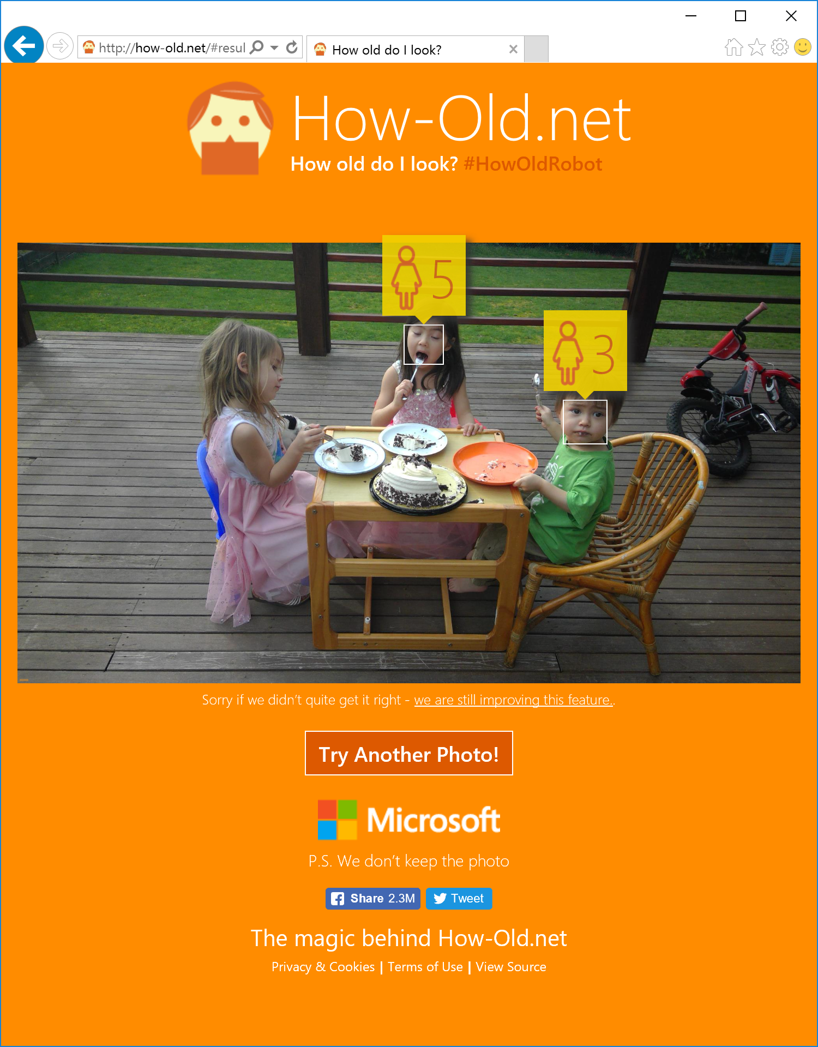
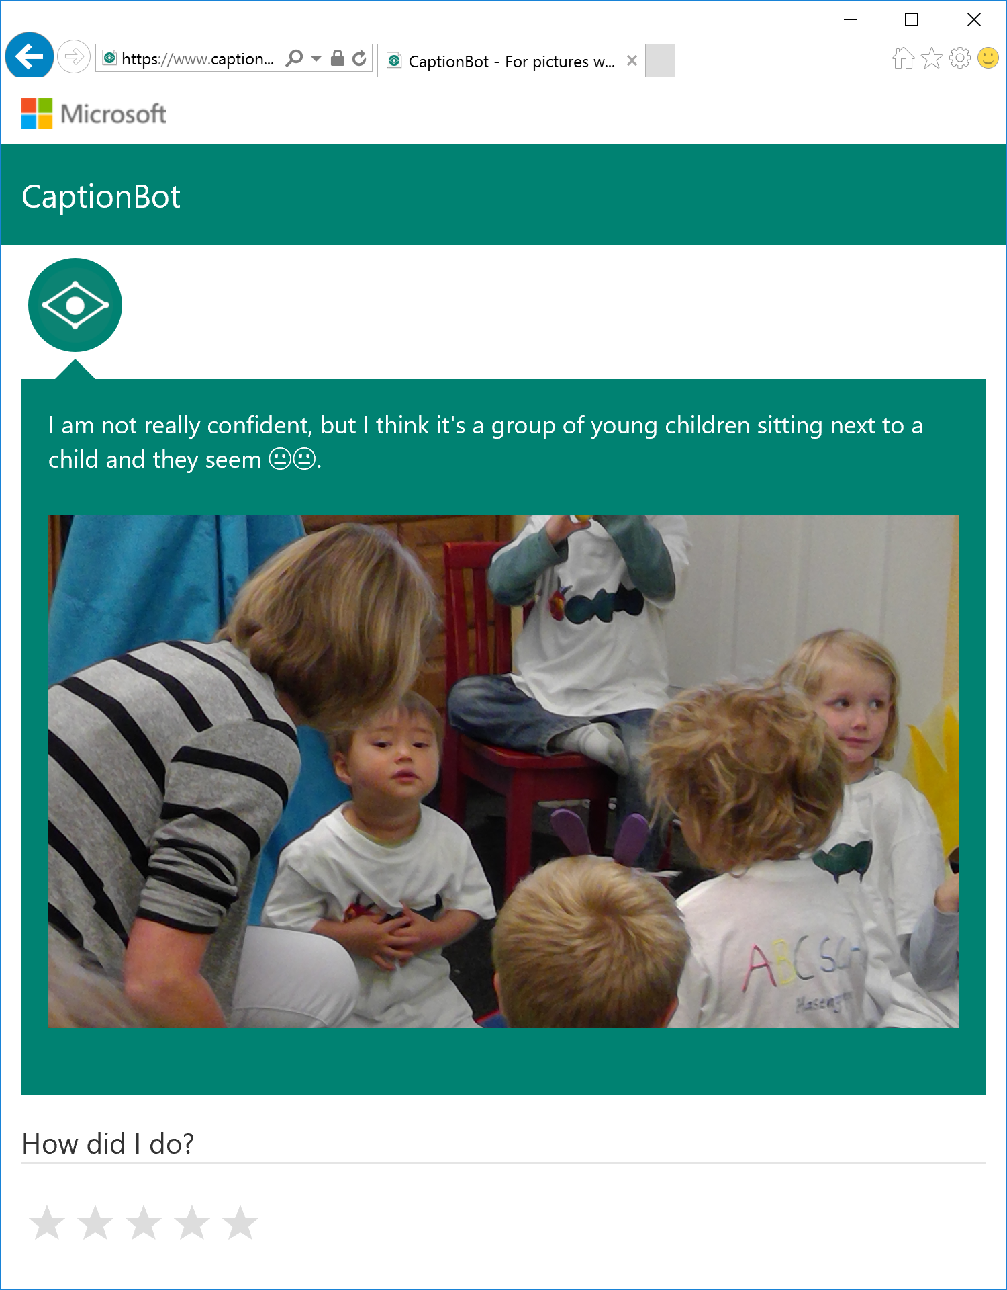

Slide 10

Microsoft’s Speech
Breakthrough
Microsoft 2016 research system for conversational speech recognition
6.2% word-error rate
all experiments were run on CNTK
[W. Xiong, J. Droppo, X. Huang, F. Seide, M. Seltzer, A. Stolcke, D. Yu, G. Zweig: “The Microsoft 2016 Conversational Speech Recognition System,” http://arxiv.org/abs/1609.03528]

Slide 11
Building Blocks

Slide 12
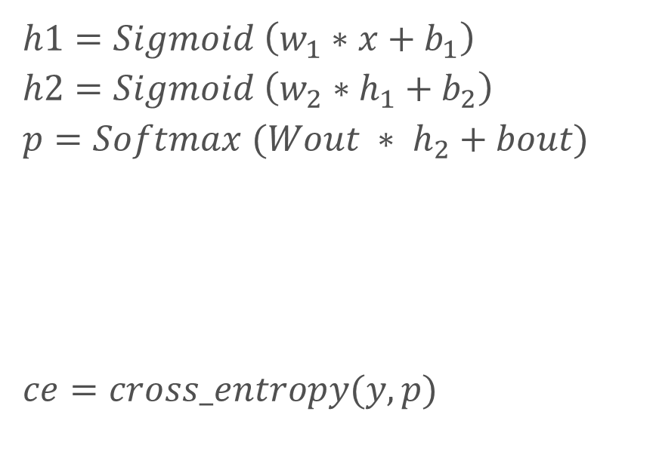
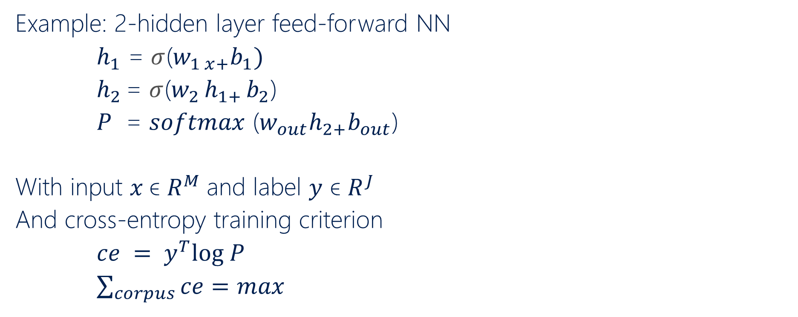
CNTK - Simple Building Blocks
Example: 2-hidden layer feed-forward NN
$h_{1}$ = $σ$($w_{1 x+}b_{1})$
$h_{2 }$= $σ$($w_{2 }h_{1+ }b_{2}$)
$P$ = $softmax$ ($w_{out}h_{2+}b_{out}$)
With input $x$ϵ $R^{M}$and label $y$ ϵ $R^{J}$
And cross-entropy training criterion
$ce = y^{T}log P$
$\sum_{corpus}{ce=max}$
$$h1=Sigmoid \left(w_{1}∗x+b_{1}\right)$$
$$h2=Sigmoid \left(w_{2}∗h_{1}+b_{2}\right)$$
$$p=Softmax (Wout ∗ h_{2}+bout)$$
$$ce=cross_entropy(y, p)$$

Slide 13
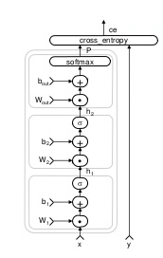
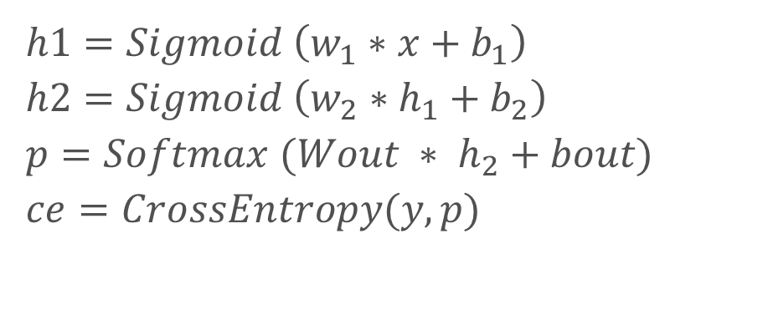
CNTK – Simple Building Blocks
$$h1=Sigmoid \left(w_{1}∗x+b_{1}\right)$$
$$h2=Sigmoid \left(w_{2}∗h_{1}+b_{2}\right)$$
$$p=Softmax (Wout ∗ h_{2}+bout)$$
$$ce=CrossEntropy(y, p)$$

Slide 14
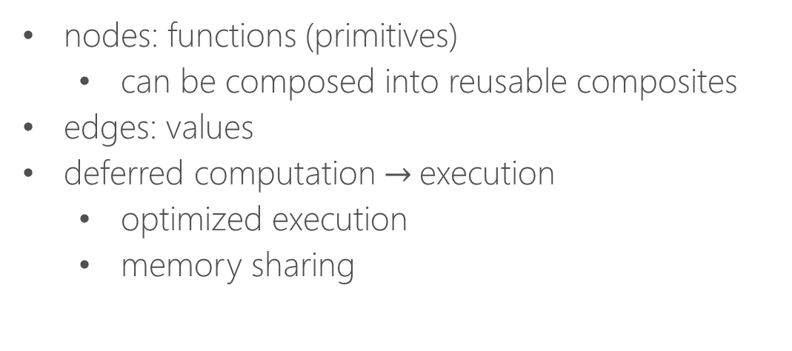
CNTK – Simple Building Blocks
nodes: functions (primitives)
can be composed into reusable composites
edges: values
deferred computation $→$execution
optimized execution
memory sharing

Slide 15
Support for a Range of Networks
Feed-forward DNN
RNN, LSTM
Convolution
DSSM
Sequence-to-sequence
For a range of applications including
Speech
Vision
Text

Slide 16
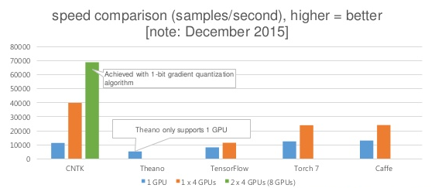
Production-Ready
State-of-art accuracy on benchmarks and production models
Multi-GPU/multi-server parallel training on production-size corpora
Notes:
Multiple GUPs = CNTK is on par
Multiple machines = Other tool kits did not support

Slide 17
CNTK Architecture

Slide 18
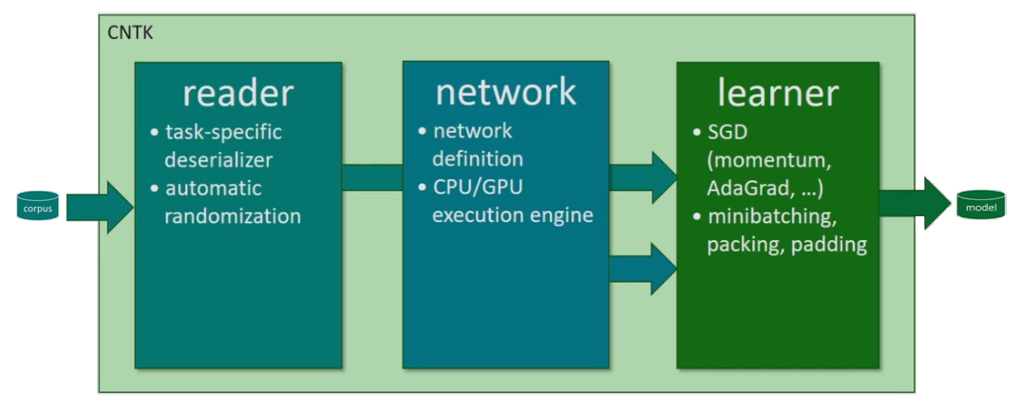
How to: CNTK Architecture
Notes:
Read Data
Describe Network
Learner – Pick SGD, Configure, etc.

Slide 19
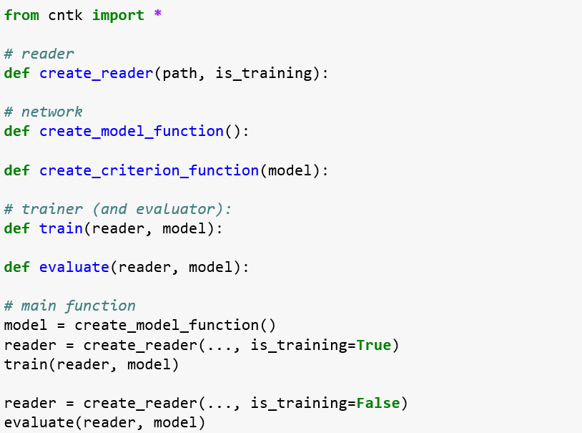
How to: Top-Level Script Outline
Notes:
What does model training mean? What do you get at the end of the training? Parameters – bias and weights
Evaluate – testing

Slide 20
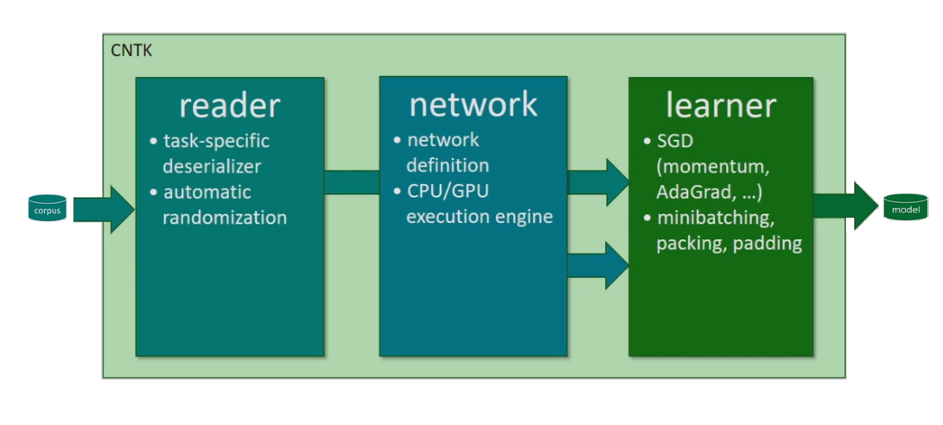
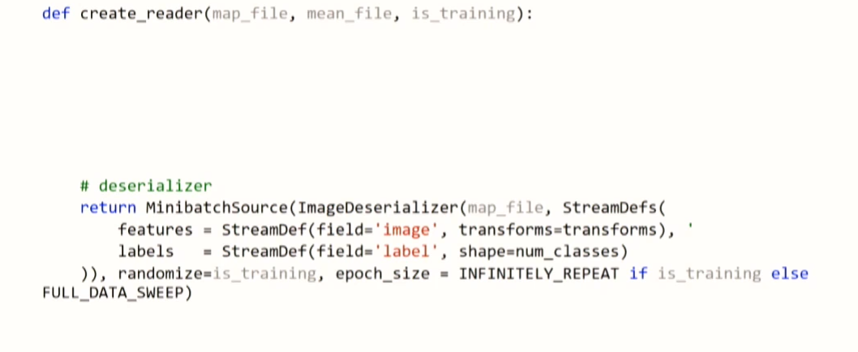
How to: Reader
Notes:
Read all data and train on that data. Measure it’s prediction, compute error and compute gradient on how the parameters have to be changed.
Instead of doing it on the entire dataset, do it in small batches.
Transforms data when you don’t have enough data or improve generalization. Data Augmentation. Reduces overfitting.

Slide 21
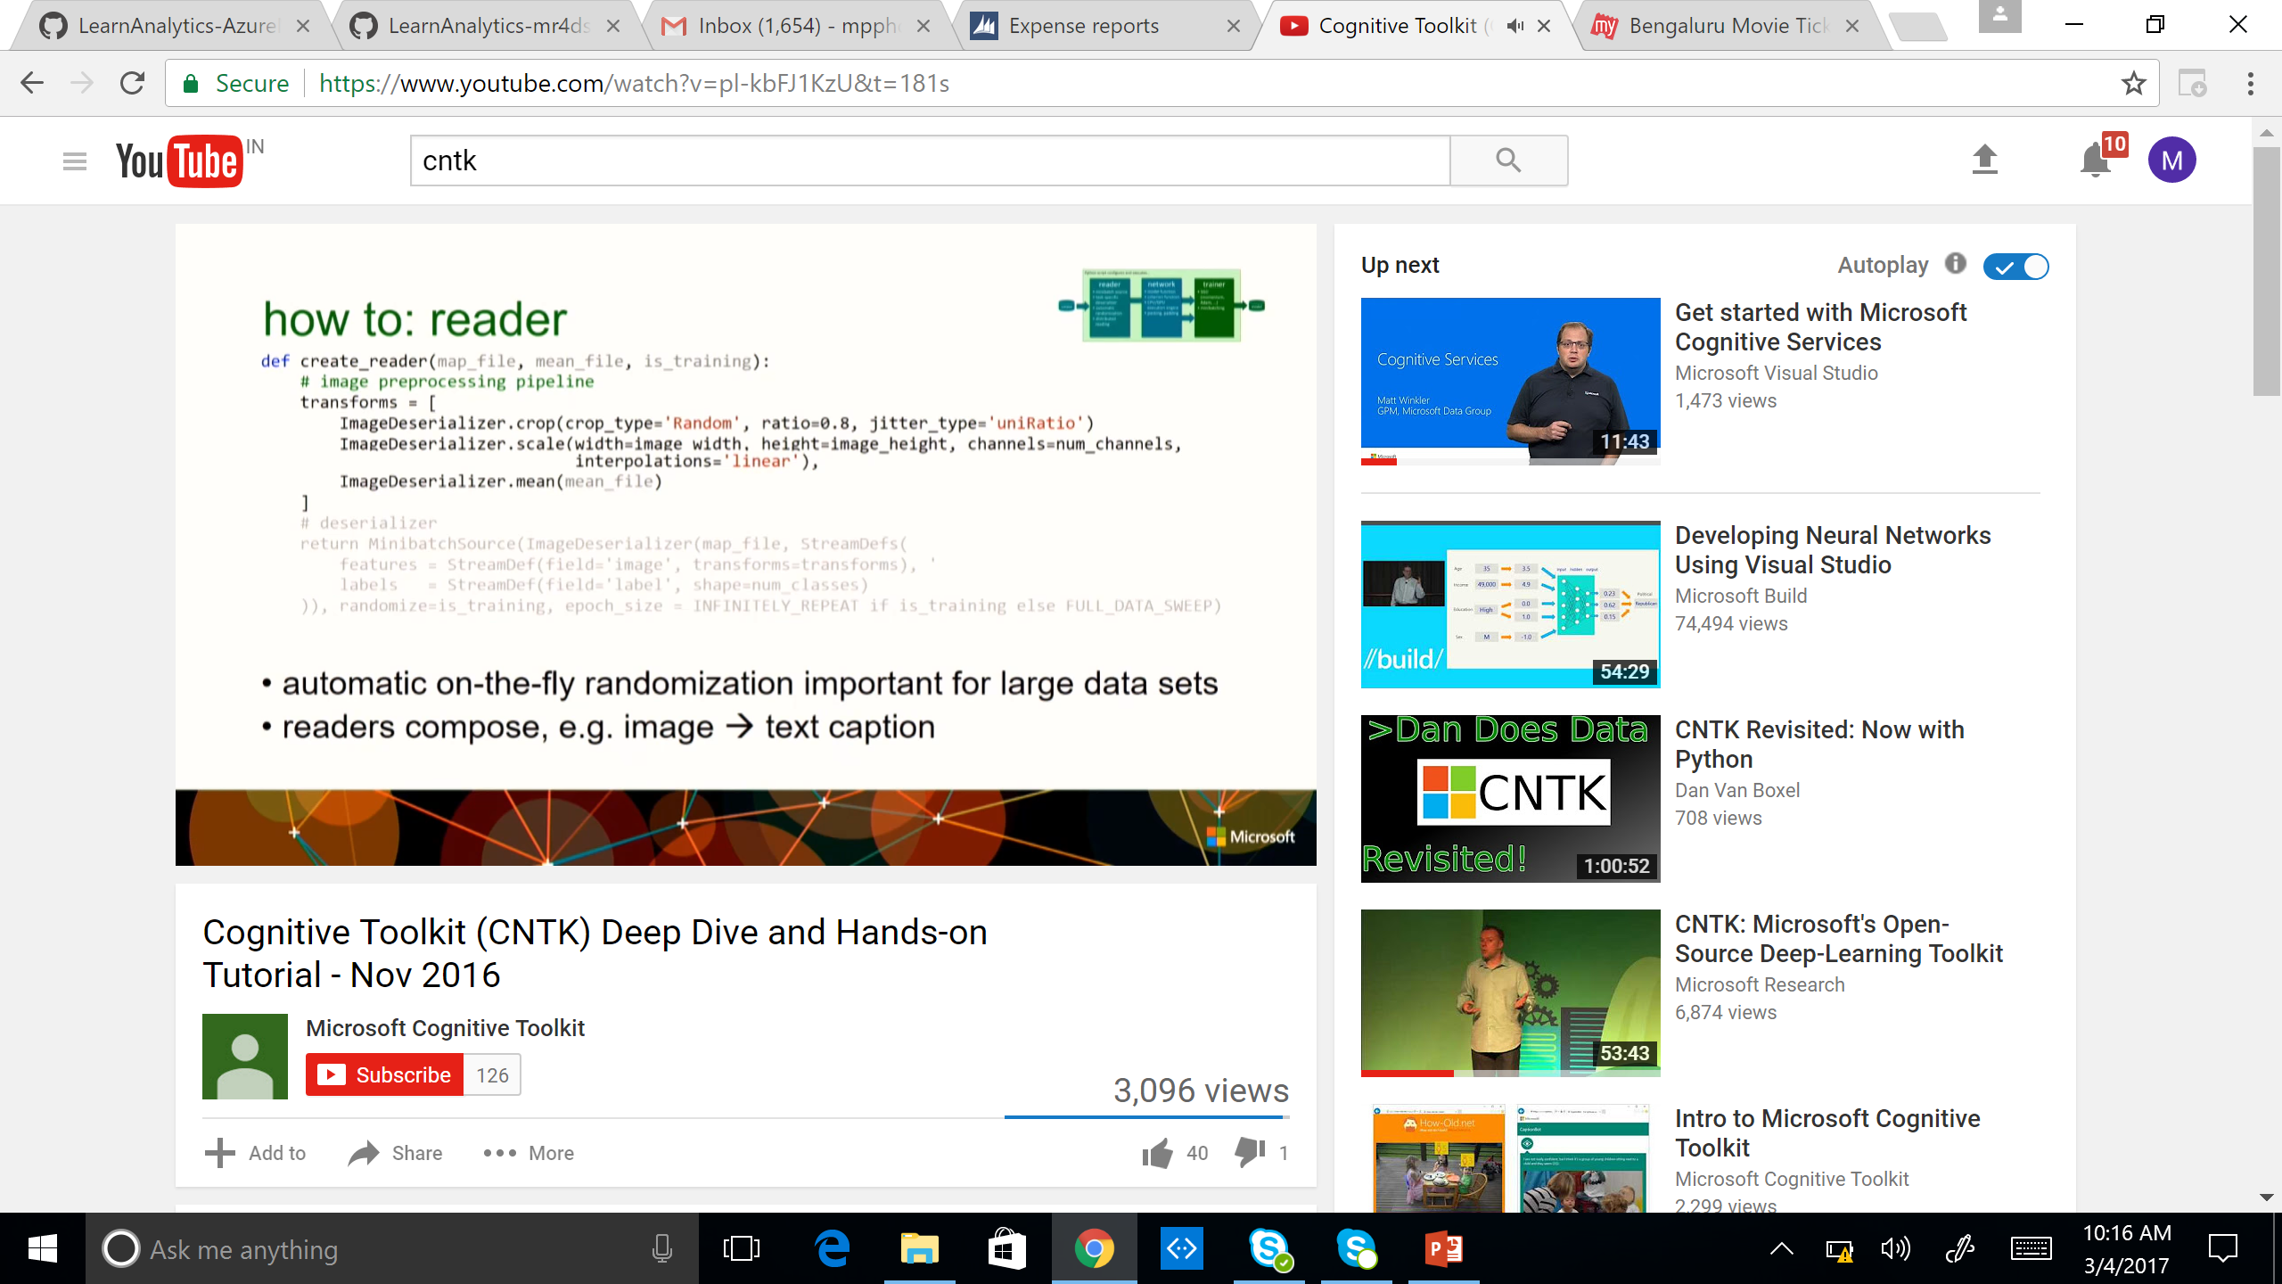
How to: Reader
Notes:
Read all data and train on that data. Measure it’s prediction, compute error and compute gradient on how the parameters have to be changed.
Instead of doing it on the entire dataset, do it in small batches.
Transforms data when you don’t have enough data or improve generalization. Data Augmentation. Reduces overfitting.

Slide 22
How to: Network
ce
CrossEntropy
P
Softmax
b_{out}
+
W_{out}
•
h1 = Sigmoid (W1 * x + b1)
h2 = Sigmoid (W2 * h1 + b2)
P = Softmax (Wout * h2 + bout)
ce = CrossEntropy (y, P)
h₂
σ
b₂
+
W₂
•
h₁
σ
b₁
+
W₁
•
x
y

Slide 23
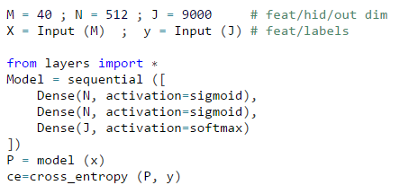
How to: Network (Sequential Representation)

Slide 24
How to: Network
ce
nodes: functions (primitives)
can be composed into reusable composites
edges: values
arbitrary-rank tensors with static and dynamic axes
automatic dimension inference
sparse-matrix support for inputs and labels
automatic differentiation
∂F / ∂in = ∂F / ∂out ∙ ∂out / ∂in
deferred computation → execution engine
optimized execution
memory sharing
editable, clonable
CrossEntropy
P
Softmax
b_{out}
+
W_{out}
•
h₂
σ
b₂
+
W₂
•
h₁
σ
b₁
+
W₁
•
x
y

Slide 25
Network
Lego-like composability allows CNTK to support a wide range of networks, e.g.
feed-forward DNN
RNN, LSTM, GRU
convolution
DSSM
Sequence-to-sequence
for a range of applications including
speech
vision
text
and combinations

Slide 26
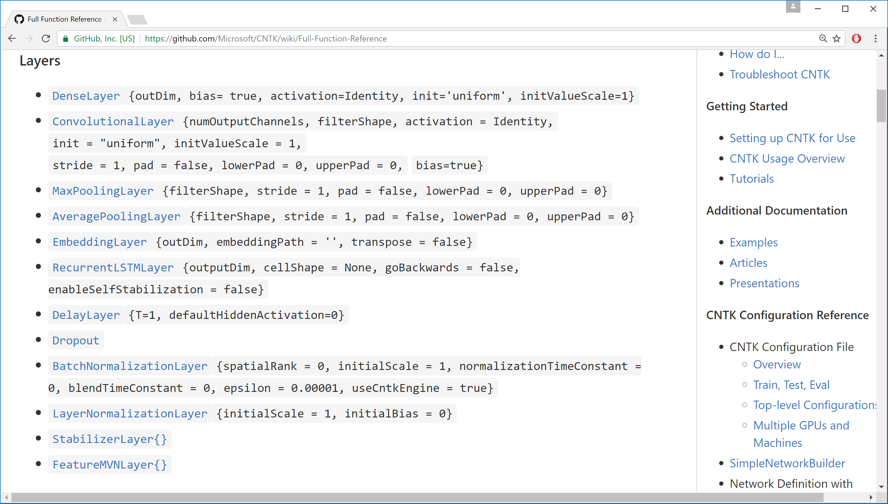
Layers

Slide 27
Learning Algorithms
AdaGrad
Adam (a low memory variant)
MomentumSGD
Nesterov
RMSProp
SGD

Slide 28
CNTK Backend for Keras

Slide 29
Keras
Keras is a high-level neural networks API
Abstracts configuration and matrix algebra to build production grade models
Developed to enable fast experimentation
Modular: Sequence or a graph of standalone, fully-configurable modules that can be plugged together with as little restrictions as possible
Documentation at Keras.io

Slide 30
Enable CNTK as Keras backend
1. Install CNTK >=2.0 and Keras
2. Two ways to setup CNTK as backend:
a. Keras.json
Update keras.json at %USERPROFILE%/.keras on Windows, or $HOME/.keras on Linux
{
"epsilon": 1e-07,
"image_data_format": "channels_last",
"backend": "cntk",
"floatx": "float32"
}
b. Environment variables
Windows: set KERAS_BACKEND=cntk
Linux: export KERAS_BACKEND=cntk

Slide 31
Summary
Setting up CNTK backend for Keras is very straightforward:
Change in configuration files
Performance optimization on CPU (in combination with Keras) is work in progress
No support for:
Convolution with dilation
Backend APIs such as reverse, top_k, map, fold1, foldr, etc.
Gradient as symbolic ops
…

Slide 32
Visualization
As of CNTK 2.2, CNTK provides support for Tensorboard and for Graphviz visualization tools.

